Slide 1
Leveraging the Serverless Architecture for Securing Linux Containers
Nilton Bila, Paolo Dettori, Ali Kanso, Yuji Watanabe*, Alaa Youssef IBM T.J. Watson Research Center – New York
*IBM Research - Tokyo, IBM Japan Ltd.
Ali Kanso, PhD
Senior Cloud SW Engineer
IBM T.J. Watson, NY

Slide 2
Leveraging the Serverless Architecture for Securing Linux Containers

Slide 3
Shipping Code
Binary
exe
elf
Packaged
JAR
WAR
Containerized
Images (dockerfiles)
Gem
But Container images can have vulnerabilities baked in them!

Slide 4
Software Vulnerabilities
Package Vulnerability
Configuration Vulnerability
E.g.: OpenSSH installed &
#PasswordAuthentication yes
#PermitEmptyPasswords
Yes (or even no)
Malware Signature
E.g.:
- Viruses
- Worms
- SpyWares
- Trojan Horses
E.g.: Ghost Vulnerability in gLibc library < 2.18
(2000→2013)

Slide 5
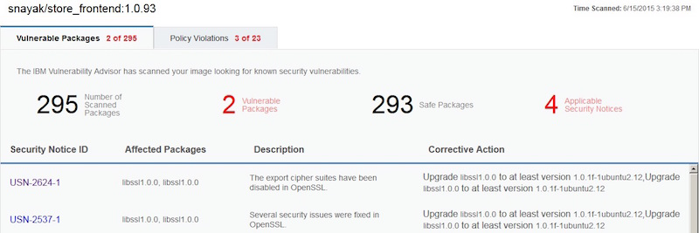
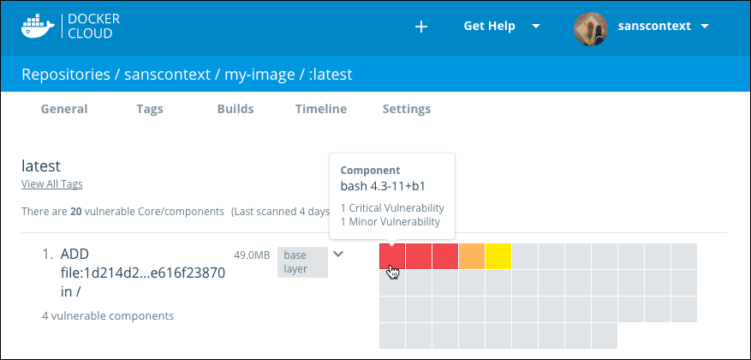
Scanning for Vulnerabilities
Scan images and deployed containers
Vulnerabilities in installed software packages
Security configuration checks
Malware signature detection
IBM Vulnerability Advisor
Docker Security Scanning

Slide 6
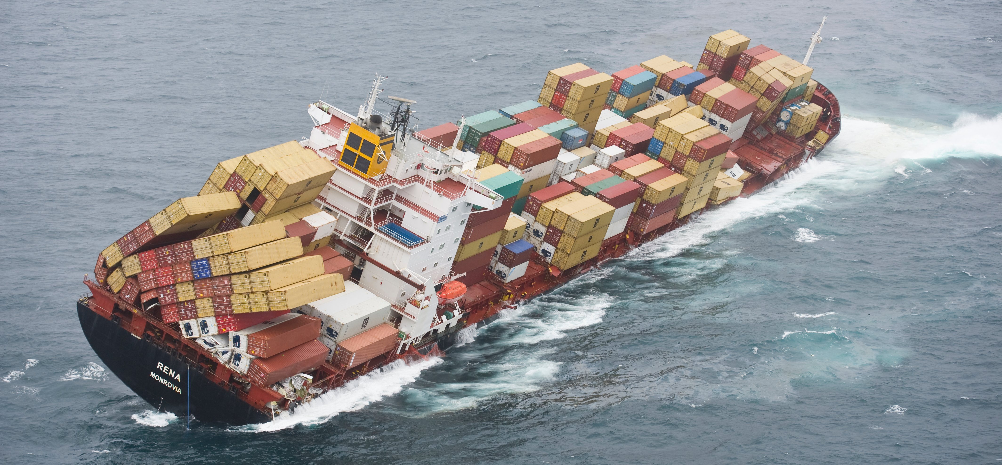

Clustering Containers
Clustering can be overwhelming
Kubernetes can help

Slide 7
What is Kubernetes?
Applications
Clustered
Containerized
Worker Node
(Minion)
Master Node
Scheduling
Monitoring
Recovery management
Auto-scaling
Authorization/Authentication…
Containerized apps
Containerized apps
Containerized apps
Kubernetes master
Monitoring
Reporting
Executing master’s recommendations…
Kubernetes agent

Slide 8
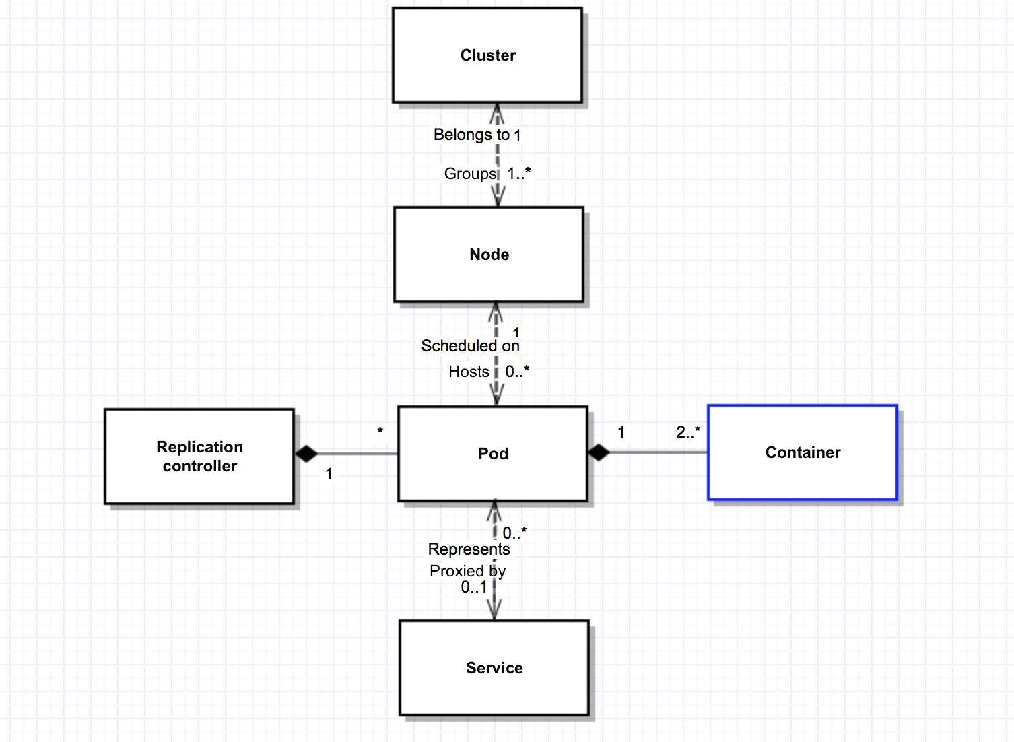
Kubernetes Resource Organization
Example pod
description
kind: Pod
metadata:
name: myPod
spec:
containers:
- name: sleep-forever
image: pause:0.8.0
resources:
limits:
memory: 1000Mi

Slide 9
K8s APIs
monolithic v1 API
Core Group
Extensions Group
REST path /api/v1
Pods
Services
Replication controllers
Resource quotas
Nodes
Endpoints
…
REST path /apis/extensions/$VERSION
Deployments
HorizontalPodAutoscalers
Ingress
Jobs
DaemonSets
Third party resources
…
Notes:
K8s API is not defined as a monolithic API component, Instead, API groups are defined to structure k8s APIs in an extensible, easy to manage manner .
The two major API groups are:
1- the “core” group, Including the main constructs in k8s such as pods, service, endpoints. This group is easily recognized with the /api REST path
2- the “extensions” group, includes later defined constructs such as DaemonSets, Deployments, HorizontalPodAutoscalers, Ingress, Jobs and ReplicaSets
This group is associated with the /apis/extensions/
In this presentation we will focus more on the third party resources and how they can be used to implement operators
An API group is specified in a REST path that makes it easier to access and manage serialized object. Such as a pod or a service

Slide 10
K8s Operators
K8s API
Third party resources
Operators
<<Extend>>
<<Leverage>>

Slide 11


K8s Third Party Resource (TPR)
http://192.168.0.15:8080/apis/myorg.com/v1/namespaces/default/securityactions
/quarantine
API path
TPR
Securityactions
quarantine
K8s Master
(API server)
<<CRUD operations>>
Resource instance: reflecting the desired state
Security action, to quarantine or delete container
<<Watch & react>>
Third-Party Software (executable)
Controller: bridging the actual state with the desired state
Notes:
The ThirdPartyResource resource describes a custom resource that the user wants to add to the Kubernetes API.
When a user creates a new ThirdPartyResource, the Kubernetes API Server reacts by creating a new, namespaced RESTful resource path
The new API object will be given an API endpoint URL and support CRUD operations, and watch API
This enables a third party software to monitor this endpoint URL, detect changes and react to those changes. Basically allowing us to implement the resource vs. controller model like the replication controller implementation that constantly inspect the replication controller object to detect any deviation from the actual state vs. the desired state. In a similar way the tpr sw acts as a controllers triggered by the extended k8s api

Slide 12
Kubernetes Limitation
K8s does not implement the needed range of actions to contain a threat
Limited to: Kill pod, Rolling-Upgrade (involves killing)
We need to have severity-based actions!
Package Vulnerability
Configuration Vulnerability
Gracefully shutdown and preserve state for future investigation
Malware Signature
Immediate kill
Quarantine until patched

Slide 13
Introducing the Security Enforcement Operator
Kubernetes master
Kubernetes Worker
Pods
Pods
Quarantine/Unqarantine
Pause/unpause
Stop/start
Fast-delete
Graceful-delete
K8s
API-server
SEO
Docker
Docker
Net-plugin
OS
OS
Based on scanning results

Slide 14
Vulnerability Scanner
Thread Intelligence
ingest threat data periodically
image configuration information
Vulnerability Scanner
Notification + summary of vulnerability findings
Image Registries
scan images
Registry Monitor
K8s Workers
security configuration checks
?
VS-agent
package vulnerability detection
malware signature detection
K8s Worker Nodes
K8s Workers
Pods
Pods
scan deployed containers
container configuration information
VS-agent
(Report from Vulnerability Advisor)

Slide 15
VS Report Example
Identify specific software package versions in the container with disclosed vulnerabilities
Identify specific issues with the container configurations

Slide 16
Leveraging the Serverless Architecture for Securing Linux Containers

Slide 17

Introducing OpenWhisk
Add/Remove/Modify
Action based policies
?
OpenWhisk
Policies
Policies
CRUD operations
K8s API server
VS
K8s API server
K8s Workers
K8s Workers
Pods
Pods
SEO
VS-agent

Slide 18
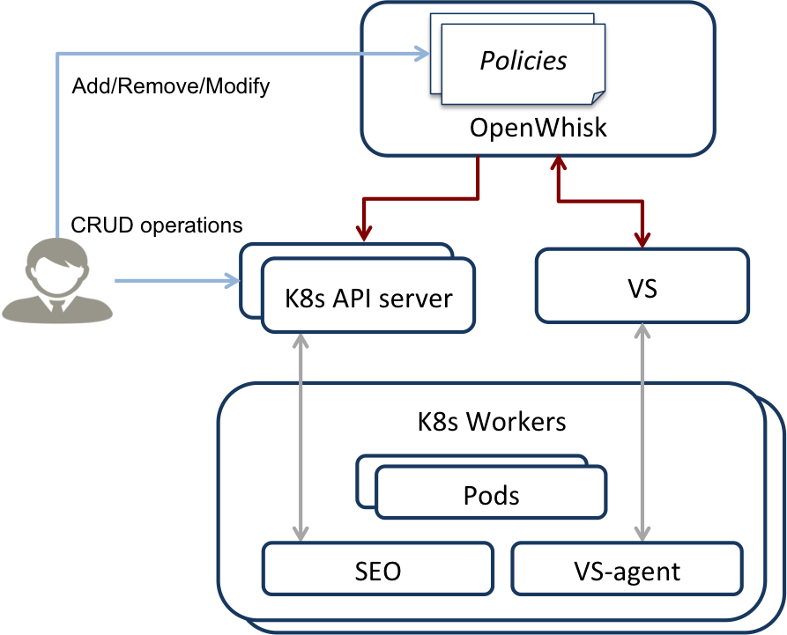
Why OpenWhisk?
OpenWhisk is the Glue between VS and K8s, it enables:
Different policies for different users
Multiple Clusters register to the same OpenWhisk deployment
Central point of policy management across clusters
Action based policies

Slide 19
Report API and Notifications on Vulnerability Scanner
Supports scans for multiple registered Kubernetes clusters.
Provide RESTful APIs for access to Vulnerability reports for each container
Use authentication token to restrict access to cluster data at the granularity of Kubernetes namespaces.
Notify events with new vulnerability findings to registered OpenWhisk API endpoints.
Trigger action invocations to the OpenWhisk API endpoints registered for the Kubernetes cluster.

Slide 20
Notifications
Per User Policy!
User creates action with known URL endpoint:
https://openwhisk.ng.bluemix.net/api/v1/web/<USER>/policy
Vulnerability Scanner posts vulnerability notification to policy endpoint
{ “clusterid”: “xyz”, “podid”: “nginx- 3382653011-3p4p0”, “vulnerability_type”: “package”, “vulnerability_status”: “vulnerable” }

Slide 21


Serverless Policy
User1: marketing
import vs import kubernetes def main(params): findings = vs.get_findings(pod_id, timestamp) vulnerable_packages = findings['vulnerable_packages'] insecure_configs = findings['insecure_configurations'] if len(vulnerable_packages) > 0: kubernetes.snapshot(pod_id) kubernetes.terminate_graceful(pod_id) return {'text': 'Deleted pod ' + pod_id } if 'remote_shell_installed' in insecure_configs: kubernetes.quarantine(pod_id) return {'text': 'Quarantined pod ' + pod_id} return {'text': 'Container was not modified ' + pod_id}
Terminate_faste(pod_id)
Terminated pod
User2: accounting

Slide 22
Interaction Summary
K8s
VS
OpenWhisk
SEO
Networking
New Pod created
Scanning triggered
Vulnerability found
Execute policy
Quarantine Pod
Quarantine Pod
Quarantine container(s)
Container(s) quarantined
Pod quarantined
Threat contained

Slide 23
Related Work
Lambdefy framework to demonstrate the differing requirements between applications deployed to IaaS and applications deployed as a cloud event, and Media Management System for showing high scalability of image resizing tasks on Lambda.
Starlight implements a kernel module that intercepts local operations on each host and passes them to a local agent which in turn passes them to an event processor that analyzes the event and determines whether or not to alert the admin.
Using Serverless in the Cloud
Securing Containers
LiCShield generates AppArmor profiles by tracing the container engine (Docker daemon) during the build and the execution of the containers.
Container Scanners
OpenSCAP (Security Content Automation Protocol) searches for an appropriate fix element, resolves it, prepares the environment, and executes the fix script.
Docker Security Scanning can scan images in private repositories to verify that they are free from known security vulnerabilities or exposures, and report the results of the scan for each image tag

Slide 24
That’s it! Questions?
OpenWhisk
Leveraging the Serverless Architecture for Securing Linux Containers
Vulnerability scanner
Security Enforcement Operator
Kubernetes

